Slide 1
Data Analysis using R
Abhishek
Dhanani

Slide 2
Overview
Introduction
Data Cleaning
Bar chart
Pie chart
Scatter plot
Presentation Title

Slide 3
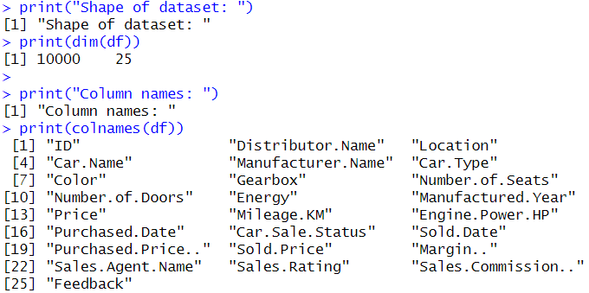
Introduction
Hello, professor. I have used a used car sales dataset which is an open source data set from Kaggle.
The data set contains fields like location, car brand, type, manufacture year, price, sale status and other fields.

Slide 4
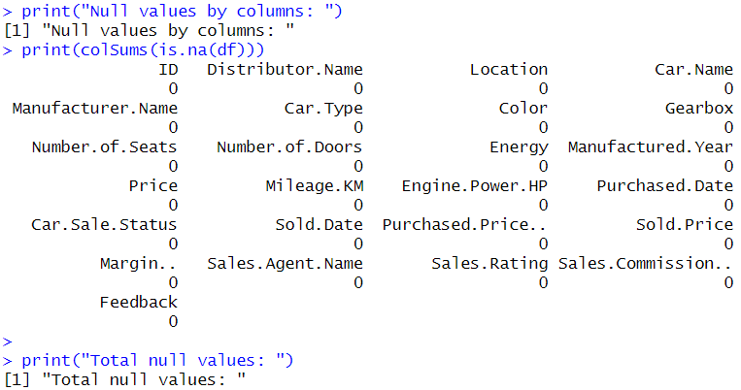
Data cleaning
Fortunately, the data was already cleaned. So I do not have to perfume data cleaning. If data had some null values or wrong values I can remove it by dropping null value rows if they were fewer, I can also replace the null values with mean, median or mode according to data. But since the data is cleaned I do not have to do any of that.

Slide 5
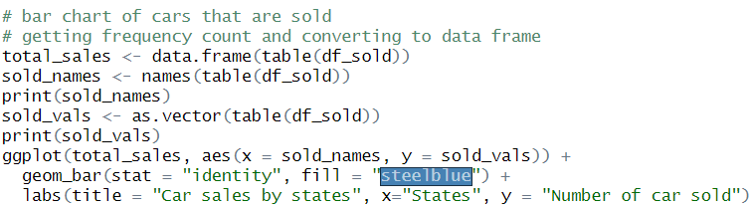
Bar chart
I have created a bar chart of car sold by cities. In this chart we can see the which state sole the most cars. We can see that north Carolina has sold most cars. Other cities kind of have similar sales while Portland being the lowest.

Slide 6
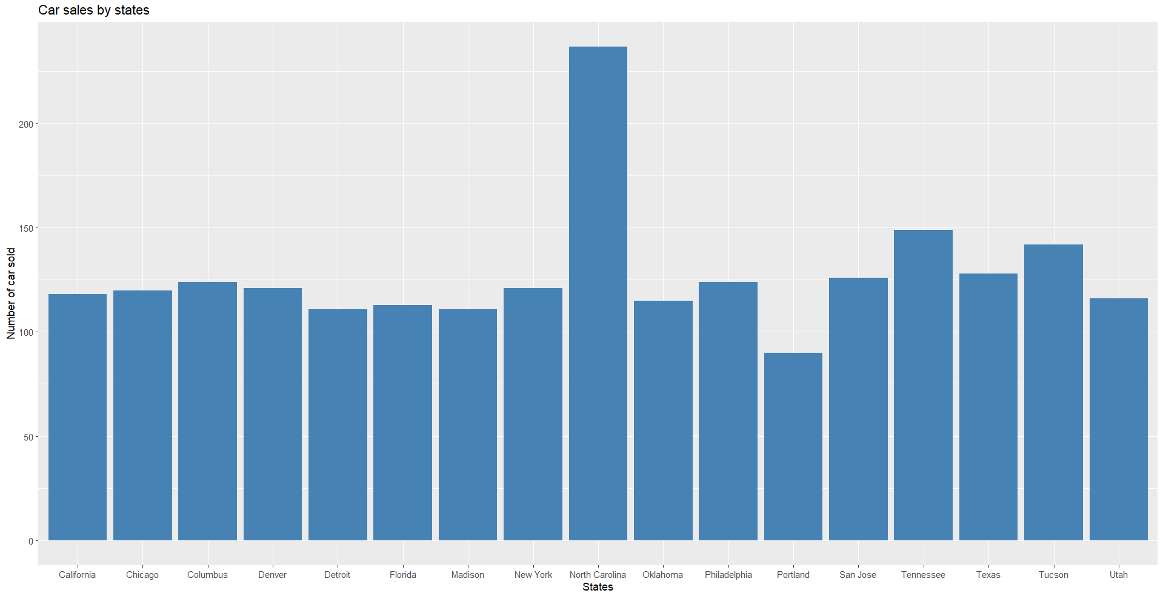

Slide 7
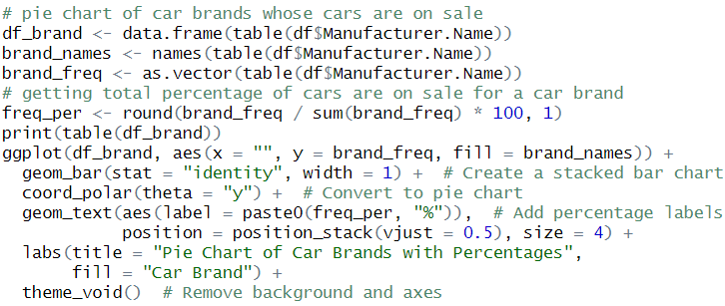
This pie chart represent the data of how many vehicles are on sale for each brand in data set.
Pie chart
I have first get the name and frequency count of brand name so that I can display the numbers. I have also got the percentages for each brand out of total. Finally used ggplot to create a bar chart and then convert it to a pie chart with percentages as labels. The chart shows that most of the cars are on sales are from Mahindra followed by Mahindra, Toyota, Hyundai and so on. While the cars from Prazo and Renault were least on sale.

Slide 8
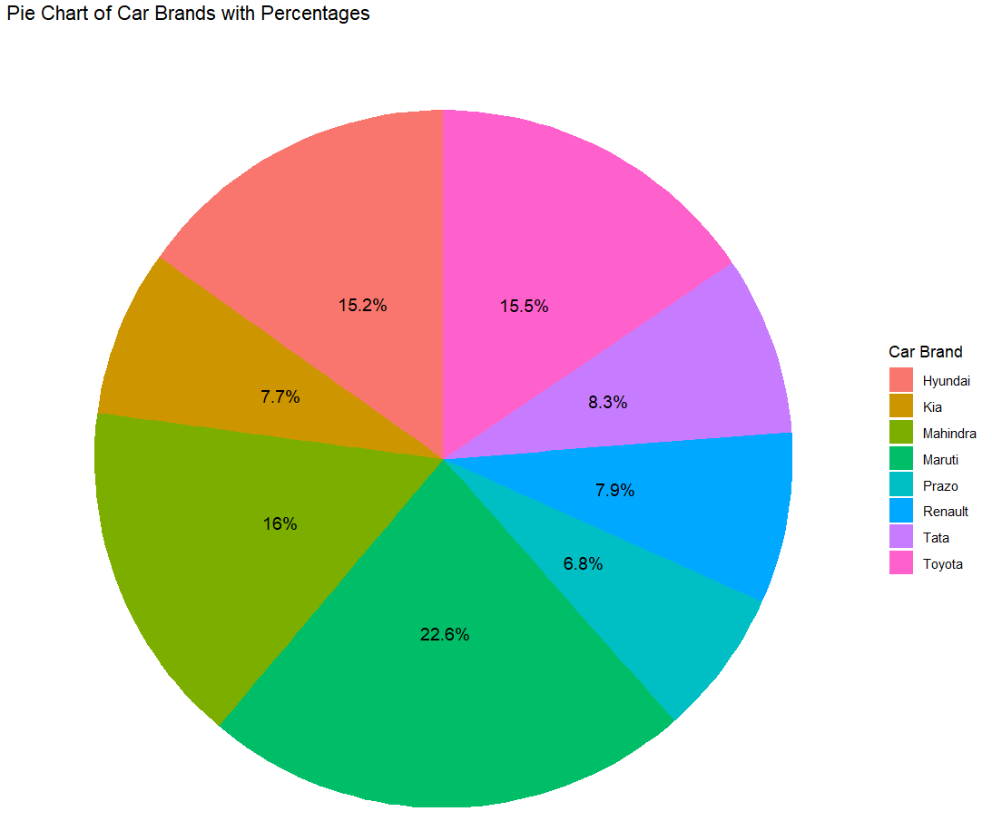

Slide 9
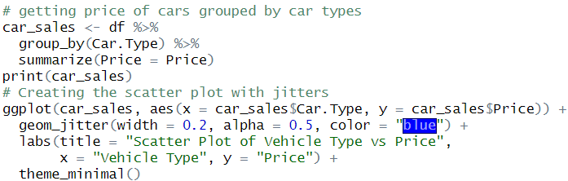
Scatter plot
I have used dplyr library to get the car price grouped by the car type.
The scatter plot show the how the car price is scattered for each of the car types. The car types are convertible, hatchback, sedan, suv and truck.
In the chart we can see the price range for convertible is highest where most of the car price ranges between 8500 to 11000 USD. While hatchbacks has the lowers range stating those car usually get the low return values. However in the chart we can see that hatchbacks has more data points which state that people are selling more hatchback car, same goes for SUVs however price range for SUVs are higher. While sedan and truck type of car price and cars on sales are more or less similar.

Slide 10
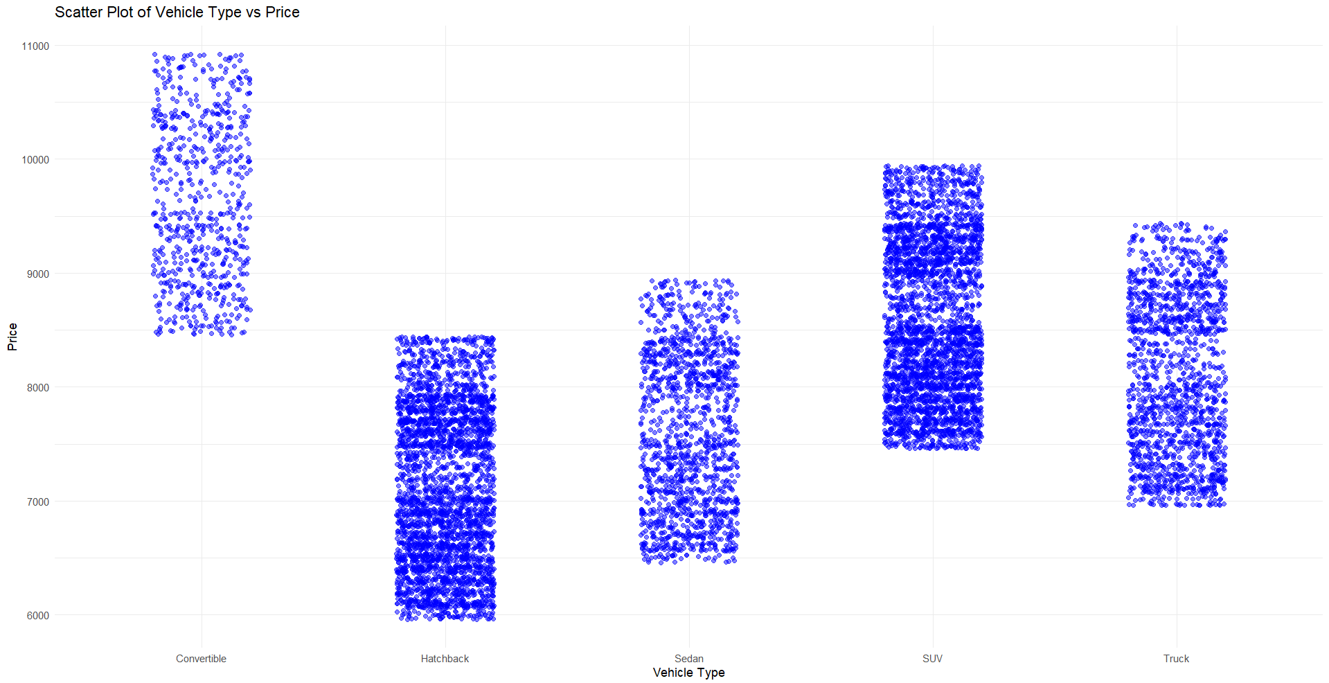

Slide 11
Creating charts are one of the crucial part of a data scientist or analyst. Charts can tell more stories then directly looking at the data. We can get more insights about the data which will help us to give a strong recommendations to business to improve it.
Summary

